Slide 1
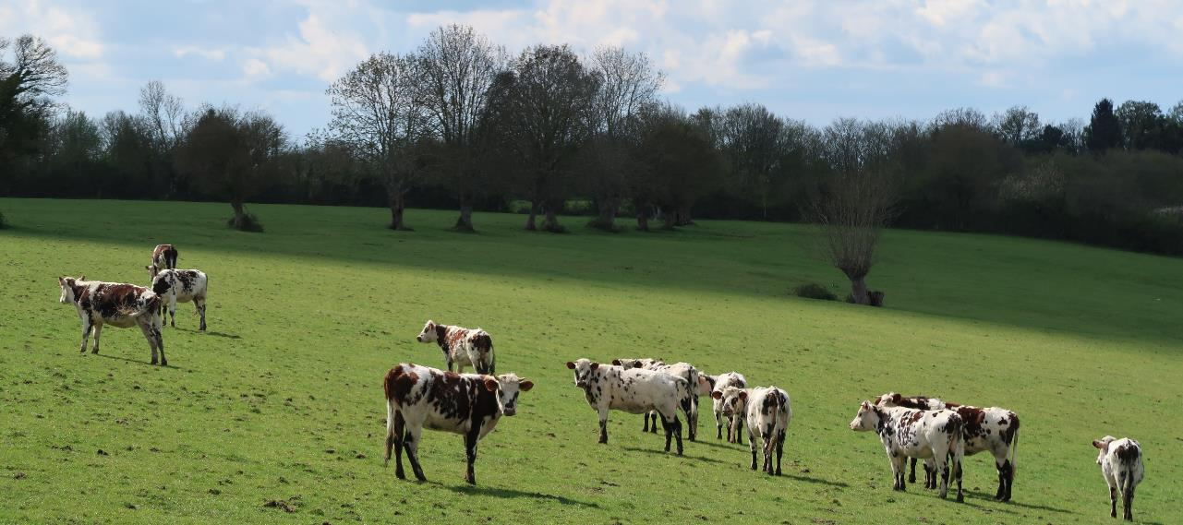

















LIFE CARBON FARMING – Carbon farming certification and rewarding mechanisms in the agricultural sector
Brussels – 25/01/2023
Ce projet bénéficie du soutien du programme LIFE de l’Union Européenne.

Slide 2


LIFE CARBON FARMING - January 25th 2023
A large audience representative of stakeholders involved in carbon transition

Slide 3
Agenda
Introduction – Jean Baptiste Dollé, IDELE
GHG mitigation policies in agriculture and carbon removals certification framework – Valeria Forlin, DG CLIMA
Tackling climate change in agriculture, lessons learnt from previous initiatives and needs for upscaling – Jean-Baptiste Dollé, IDELE
Presentation of the LIFE CARBON FARMING project – Idele, Asoprovac, ATB, U Liège, CREA, Eilyps
Testimonies on Carbon Farming implementation – Elisabeth Pagnac-Farbiaz, French Ministry of Ecological Transition / Pierre Rayé, FCAA / Donal O’Brien, Teagasc
Lunchbreak
Workshop sessions
  How to build an efficient monitoring and certification process for answering project developers, carbon buyers and public body’s needs?
  What funding mechanisms to support low carbon projects?
Networking
Workshop restitutions
Questions/Answers with a panel of experts – Marion Leguiel, French Ministry of Agriculture / Adeline Favrel, Clothilde Tronquet, I4CE / Donal O’Brien, Teagasc / Pierre Rayé, FCAA
Conclusion – Jean-Baptiste Dollé, IDELE

Slide 4
LIFE CARBON FARMING wokshop
GHG mitigation policies in agriculture and carbon removals certification framework – Valeria Forlin

Slide 5
Commission proposal for a Carbon Removal
Certification (CRC) Regulation
Valeria FORLIN – DG CLIMA

Slide 6
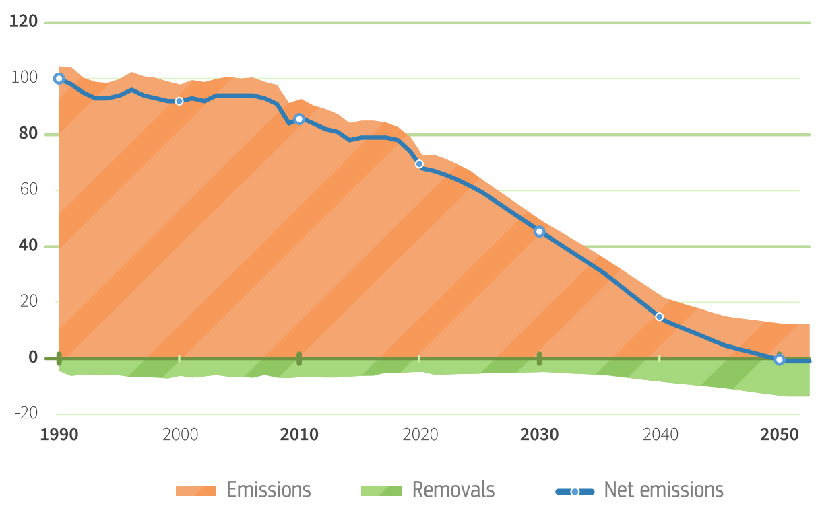
Why carbon removals?
Drastically reduce emissions
Roughly double carbon removals
Climate neutrality
GHG projections for climate neutrality
1990 GHG emissions = 100
Source: EU 2030 Climate Target Plan

Slide 7
The policy context
Climate Law
Land Use, Land Use Change and Forestry (LULUCF) Regulation
Communication on Sustainable Carbon Cycles
EU objective of climate neutrality by 2050
ambitious target for net carbon removals in soils, forests and wood products: -310 Mtonnes by 2030
roadmap to enable carbon removals:
carbon farming should contribute to 2030 target for LULUCF
industrial solutions should remove at least -5 Mtonnes in 2030

Slide 8



Different types of carbon removal activities
PERMANENT STORAGE
CARBON FARMING
CARBON STORAGE IN PRODUCTS
E.g. Bioenergy with Carbon Capture and Storage (BECCS), Direct Air Carbon Capture and Storage (DACCS)
E.g. Af-/re-forestation, improved forest management, agroforestry, soil carbon sequestration, peatland restoration
E.g. Use of wood-based materials in construction, long-lasting Carbon Capture and Utilisation (CCU)

Slide 9
Why certify carbon removals?
Incentivising high-quality carbon removals
Fighting greenwashing & build trust
Harmonise market conditions
Tailored certification methodologies

Slide 10
From objectives to the legal proposal
Legislative Proposal
Art. 1-3: General provisions
1: Scope
2: Definitions
3:Eligibility
Incentivising high-QU.A.L.ITY carbon removals
Fighting greenwashing & build TRUST
HARMONISATION of market conditions
TAILORED certification methodologies
Art. 4-8: Quality criteria
4: Quantification
5: Additionality
6: Long-term storage
7: Sustainability
8: Certification methodologies
Art. 9-14: Certification &
Certification schemes
9: Certification of compliance
10: Operation of certification bodies
11: Operation of certification schemes
12: Registries
13: Recognition by the Commission
14: Reporting
Art. 15-18: Final provisions

Slide 11





QU.A.L.ITY criteria for all carbon removals
Quantification
Additionality
Long-term storage
Sustainability
Carbon removal activities are measured accurately and deliver unambiguous benefits for the climate
Carbon removal activities go beyond market practices and what is legally required
Certificates clearly account for the duration of carbon storage and distinguish permanent storage from temporary storage
Carbon removal activities do not harm the environment or even benefit other environmental objectives such as biodiversity
To operationalise the EU quality criteria, the Commission, supported by an expert group, will develop tailored certification methodologies for the different types of carbon removal activities

Slide 12

Requirements for certification
Third-party verification
Reliable certification schemes
PUBLIC registries of carbon removals
Carbon removal activities should be verified by independent auditors
Certification schemes should have a trustworthy governance system in place
Carbon removals should be recorded in interoperable registries to avoid double-counting
The Commission will recognise certification schemes that should be used by operators to demonstrate compliance with the Regulation

Slide 13
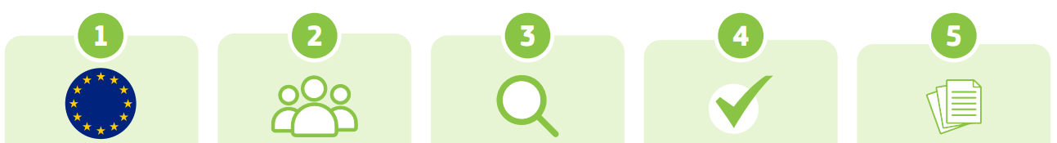
How does it work?
EU develops methodologies & recognises certification schemes
Operators
join an
EU-recognised certification scheme
Third-party verification of the activity
The activity is periodically certified
Certified carbon removals are recorded in registries

Slide 14
How can the CRC Regulation can be used?
Public support
Achieve climate targets, e.g. LULUCF, Nature Restoration Law
Targeted support under CAP, State Aid, Innovation Fund…
Private financing
Fight greenwashing
Corporate Sustainability Reporting
Supply chain contracts
Improve transparency and integrity of voluntary carbon markets
No link with the EU ETS
Green claims

Slide 15
Useful links
Proposal: https://climate.ec.europa.eu/document/fad4a049-ff98-476f-b626-b46c6afdded3_en
Impact Assessment: https://climate.ec.europa.eu/document/ab53e63b-4b85-4d28-ac67-6bd742506bae_en
Press release: Commission proposes certification of carbon removals (europa.eu)
Q&A: https://ec.europa.eu/commission/presscorner/detail/en/qanda_22_7159
Factsheet: https://ec.europa.eu/commission/presscorner/detail/en/fs_22_7161
More information on Sustainable Carbon Cycles: https://ec.europa.eu/clima/eu-action/forests-and-agriculture/sustainable-carbon-cycles_en
Delivering the European Green Deal: https://ec.europa.eu/info/strategy/priorities-2019-2024/european-green-deal/delivering-european-green-deal_en

Slide 16
LIFE CARBON FARMING wokshop
Tackling climate change in agriculture, lessons learnt from previous initiatives and needs for upscaling –
Jean-Baptiste Dollé, Catherine Brocas - IDELE

Slide 17








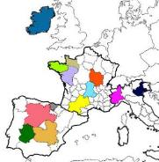




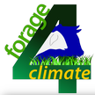


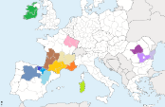










From research to practice
Initiatives for disseminating low carbon practices
LIFE CARBON DAIRY
LIFE BEEF CARBON
LIFE Green Sheep
FBL
Dairy4Future
Sustainable goat FARMING

Slide 18
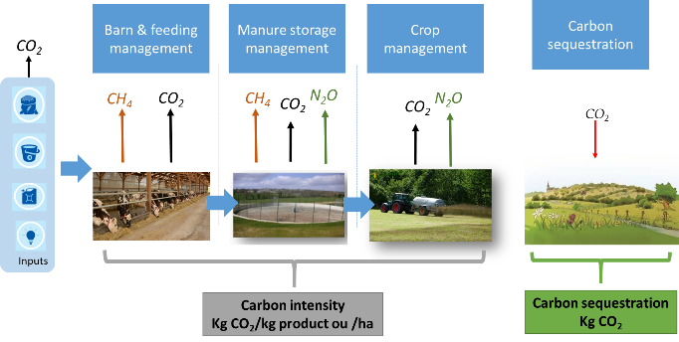
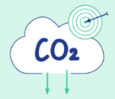

First, quantifying GHG emissions and carbon sequestration
Milk carbon footprint
Kg CO₂/l milk
Notes:
Whole farm assessment, complex but crucial to looking for a sustainable action plan and avoiding burdens transfer

Slide 19
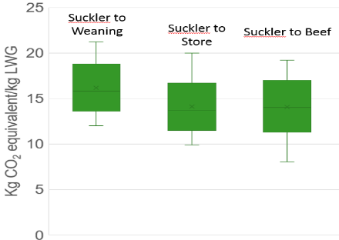
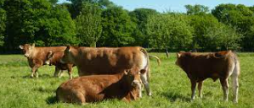



High variability between farms
Suckler to weaning
Suckler to finish (heifers)
Suckler to finish (bull)

Slide 20




A 20% potential in reducing GHG emissions now
High difference between efficient and less efficient farms
17%
29%
20%
73 farms
290 farms
8 300 dairy farms
Notes:
18% lower
The carbon footprint of milk was found to be around 1 kg CO eq per litre of milk.
There is no clear difference between productions systems for the lowland farms. The mountains farms presented a milk carbon footprint much higher.
But there is high difference between efficient and not efficient dairy farms.
A focus analysis on the 10% of farms getting the lower milk GHG emisisons results has been done.
In this group of 333 farms, the average GCF is 0.85 kg CO₂e / l FPCM. The difference between GCF observed on all farms and this sample is 18%. This difference highlights the gap in relation with farm and practices performances.
I show you the results of all the farms without any distinction of the production system but we find the same conclusion for all of them. The gap between the top10% and mean of every production system ranging from 15% to 23%.
And the repartition of the differents production system in the global sample and the TOP 10% sample i the same.

Slide 21
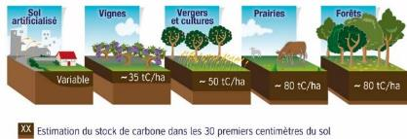
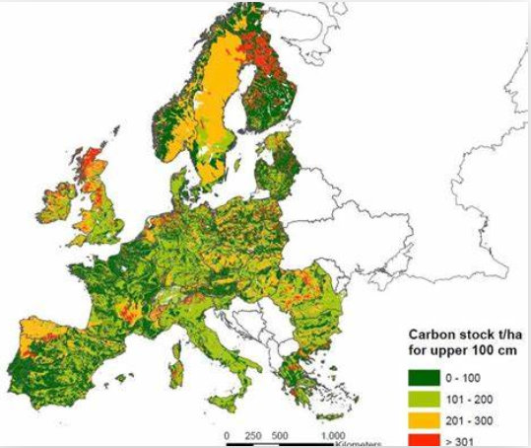


Carbon sequestration : Stock and storage!
Sol et carbone, 2014
1/ Maintaining carbon stock
Removals target : 310 millions CO2 by 2030
2/ Increasing carbon removals
European soil data centre

Slide 22
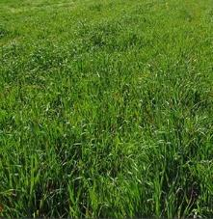
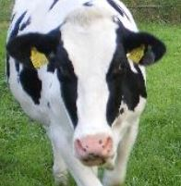




The whole farm approach for assessing Technical&carbon performances
Carbon and nitrogen cycle
Inputs
Purchased feeds
Manure
Pastures and crops
Livestock
Forage,
Concentrates
Crops sold
Milk, meat
Notes:
degrade

Slide 23






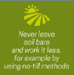







Mitigation,
More than 40 practices ready to use
GHG emissions
Carbon sequestration
Crops management & fertilization
Legume crops,
Optimization of fertilizers uses
Rotation
Energy
No-till cultivation,
Power and equipment,
Working organization
Renewable energy
Cover crops
Avoid bare soil
Inputs
Concentrates and fertilizers,
Pasture management,
Legumes
Feed
Feed efficiency,
Forage quality and yield
Agroforestry
Manure management
Manure storage&application
Time spent in shed vs pasture,
Biogas production
Livestock management
Improving productivity
Reducing number of unproductive animals, lipids
Grassland management
The first step → A room for improving carbon footprint up to 15% to 25%

Slide 24

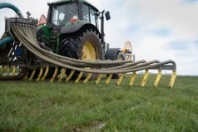
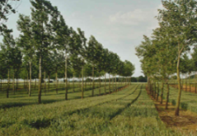
Emerging solutions for tomorrow
Methane emissions
  Genetic
    Adaptation to CC
    Feed efficiency in livestock production
    Methane emissions
  Feed additives
    3 NOP, tanins, algae, citrus
Manure & nitrogen management
  Additives, nitrification inhibitors
  Protected urea
Agroforestry
…
-10%
-30%
Genetic
Feed Additives

Slide 25
CO₂ avoided for an average cattle farm
Quantity of concentrates and lipids
Age at first calving
Leguminous
Hedges
GHG reduction and carbon sequestration
Reduction of the milk/beef carbon footprint : 15 to 20 %
On a 5 years project : # 300 - 500 tons
75-80% = CO2 reduction
20-25% = carbon removal

Slide 26
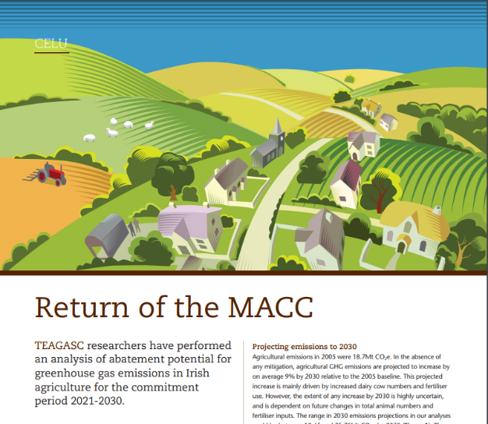
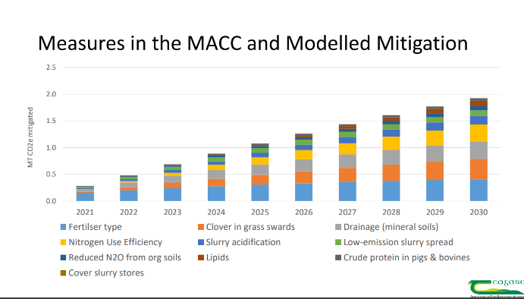
Mitigation cost : MACC from Irland…

Slide 27
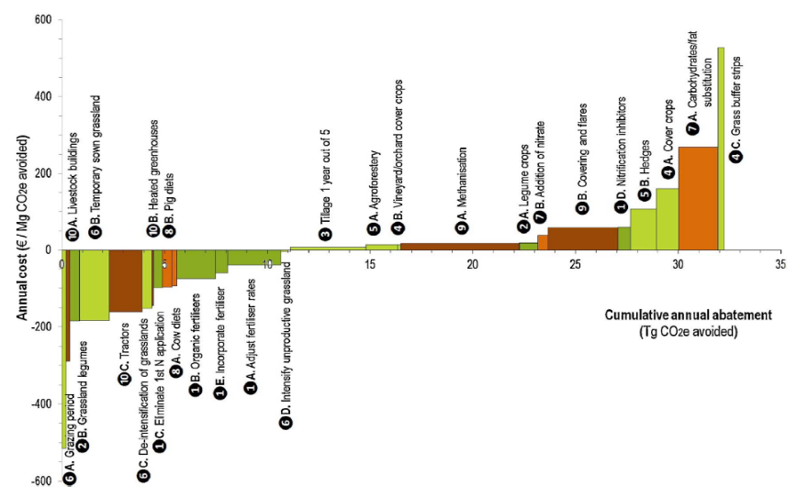

To french mitigation costs
Cost effective
< 0 € / t eq.CO₂
Intermediate cost
0-25 € / t eq.CO₂
High cost
> 25 € / t eq.CO₂
Pellerin et al., 2013
Notes:
Marginal abatment cost curve presents the costs or savings expected from different opportunities, alongside the potential volume of emissions that could be reduced if implemented.

Slide 28
What is the cost for farmers ?
v
Abatement costs
Quantity of concentrates and lipids
Age at first calving
Leguminous
Hedges
v
MRV costs
Farm audit
Mitigation action plan
Technical advise
CO2 reduction quantification
Verification and certification
Contracting procedures
GHG reduction and carbon sequestration
- 40€ to > 100 €/tons CO2
5€ to >10€/tons CO2

Slide 29

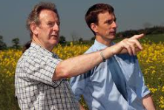
Conditions for upscaling carbon farming
Raising awareness and capacity building
Climate and other issues
Partnership
Funding solutions
SMRV
Farmers oriented
Farmers must not only be part of the initiative, we have to give them ownership of this climatic transition
Notes:
At the heart of the process

Slide 30
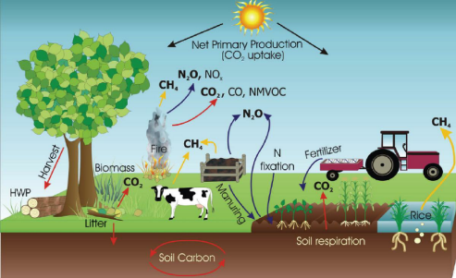
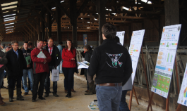
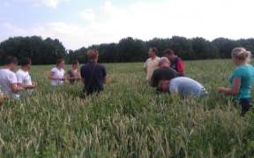


Raising awareness and capacity building
Training sessions for farmers and advisers
Demonstration actions, peer to peer learning
Living labs for testing innovative solutions
Communication tools (conferences, farm open days, press,…)

Slide 31




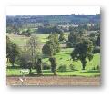







Climate and other issues i.e. considering sustainability issues
GHG
Climate change
Air quality
Ammonia
Biodiversity
Carbon removal
Territory
Soil
Soils fertility
Adaptation to CC
Water
Eutrophication
Eau
Water consumption
8 300 dairy farms

Slide 32

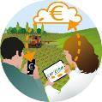




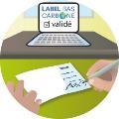
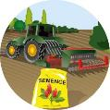


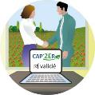
SMRV,
Supporting, Monitoring, Reporting, Verifying
Defining baseline
1st Audit
Paying farmers for carbon reductions
Building up mitigation action plan
MRV rules
Farmers’ technical support
tons CO2
Verifying and certifying the carbon reduction
Applying mitigation measures
Quantifying CO₂ reductions
2nd Audit

Slide 33


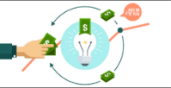
Coordinating result based and practice based funding sources ?
SMRV costs
Public fundings
Voluntary contribution to low carbon projects
Financing from value chain
Premium products
Regions and countries
EU (CAP)
Other ?
Voluntary purchase of carbon credits
Companies,
Communities or individuals
RISK AVERSION
INVESTMENTS NEEDED

Slide 34
The partnership is crucial to success
Producer associations
Research sector
Interprofessions
National and regional bodies
Carbon buyers
Bank sector
Agri -Food industry
Advice companies
National & EU levels
  Research activities and experimentation
  Common framework (methodologies, tools,…)
  Dissemination
  Funding solutions
Complementary skills
  Recruiting farmers
  Technical/environmental expertise
  Communication
  Financial value and economic development
Farmers

Slide 35

LIFE CARBON FARMING
Building the successive steps for involving farmers
Carbon Certification
Information - Training
Farm assessment
Carbon mitigation action plan
Monitoring
Carbon certification
Carbon Mitigation
  A whole farm approach for avoiding leakages
  GHG emissions and C sequestration
  A common carbon accounting methodology
  Ensuring a strong environmental integrity
  Partnership for upscaling
  A cost-effective MRV
  Rewarding mechanisms
  …

Slide 36
LIFE CARBON FARMING wokshop
Presentation of the LIFE CARBON FARMING project

Slide 37
Presentation of the LIFE Carbon Farming project
Objectives and partners
Elaborating harmonised tools and standards to implement low carbon initiatives on farms
  Sustainable assessment of farms
    A common MRV framework to certify low carbon projects on European farms
  Implementing low carbon projects in 700 mixed-crops livestock farms
  Elaborating reference costs of low carbon projects
  Implementing a result-based rewarding mechanism
  Implementing a low carbon network
  Inputs of the project for the Carbon Farming

Slide 38
Presentation of the LIFE Carbon Farming project
Objectives of the project:
Tackling climate change by reducing by 15% the carbon footprint of 700 farms in 5 years
Involving the farmers for the implementation of low carbon practices
Developing a result-based rewarding mechanism through a common certification framework, MRV
Positive impacts on other environmental and socio-economic indicators
Elaborating reference costs of low carbon projects

Slide 39
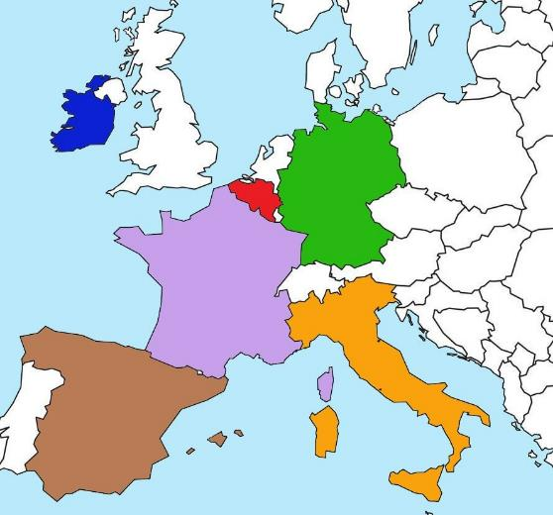












Partners of the LIFE Carbon Farming project
Country | Partners
Germany | ATB
Belgium | Université de Liège
Spain | ASOPROVAC, Factor CO2, Neiker
France | Idele, I4CE, Eliance, Interbev, CNIEL, La Coopération Agricole, Chambres d’Agriculture France
Ireland | Teagasc
Italy | CREA, CRPA

Slide 40
What can bring the LIFE Carbon Farming project regarding the context in Germany?
LIFE Carbon Farming – Workshop on 25th January
  → A first project on certification in a country where there is no existing certification framework on farm’s scale.
Aura Cárdenas and Barbara Amon
Acardenas@atb-Potsdam.de

Slide 41
What can bring the LIFE Carbon Farming project regarding the context in Germany?
German participation
  - will allow us to evaluate which measures are best suited to the German context.
  - will allow to follow closely the advances in terms of carbon certification and to see its applicability in the country.
  - Baseline for future Scale up
  - We will be a reference point for future projects, the lessons learned will be taken into account to formulate and execute new projects at the farm level
  …..

Slide 42
Technical actions
Action C.1. : Elaborating harmonised tools and standards to implement low carbon initiatives on farms
Action C.2. : Implementing low carbon projects in 700 mixed-crops livestock farms in France, Belgium, Germany, Ireland, Italy and Spain
Action C.3. : Elaborating reference costs of low carbon projects
Action C.4. : Implementing a result-based rewarding mechanism
Action C.5. : Implementing a low carbon network
Action C.6. : Replication action – a common framework for a European CARBON FARMING strategy

Slide 43
Presentation of the LIFE Carbon Farming project
Objectives and partners
Elaborating harmonised tools and standards to implement low carbon initiatives on farms
  Sustainable assessment of farms
    A common MRV framework to certify low carbon projects on European farms
  Implementing low carbon projects in 700 mixed-crops livestock farms
  Elaborating reference costs of low carbon projects
  Implementing a result-based rewarding mechanism
  Implementing a low carbon network
  Inputs of the project for the Carbon Farming

Slide 44
Elaborating harmonised tools and standards to implement low carbon initiatives on farms
Methodology for an environmental and socio-economic assessment
→ State of play in year 1 : first carbon audit on farm
MRV process to follow to certify the carbon footprint reduction between 2 audits: baseline, follow-up of the reductions, verification, etc.
Methodology for an environmental and socio-economic assessment
→ State of play in year 5 : second carbon audit on farm

Slide 45
Presentation of the LIFE Carbon Farming project
Objectives and partners
Elaborating harmonised tools and standards to implement low carbon initiatives on farms
  Sustainable assessment of farms
    A common MRV framework to certify low carbon projects on European farms
  Implementing low carbon projects in 700 mixed-crops livestock farms
  Elaborating reference costs of low carbon projects
  Implementing a result-based rewarding mechanism
  Implementing a low carbon network
  Inputs of the project for the Carbon Farming

Slide 46
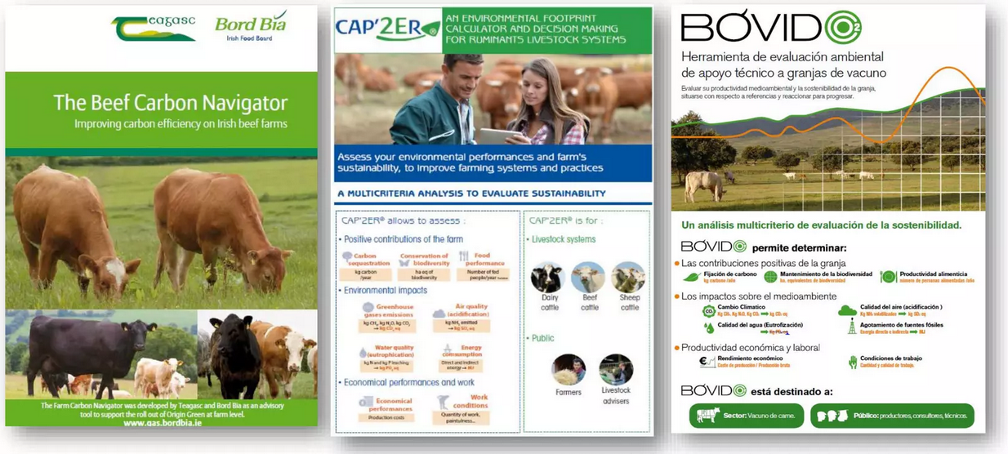
Elaborating harmonised tools and standards to implement low carbon initiatives on farms
Three tools used in the frame of the project

Slide 47
Elaborating harmonised tools and standards to implement low carbon initiatives on farms
Overall assessments carried out on farms

Slide 48
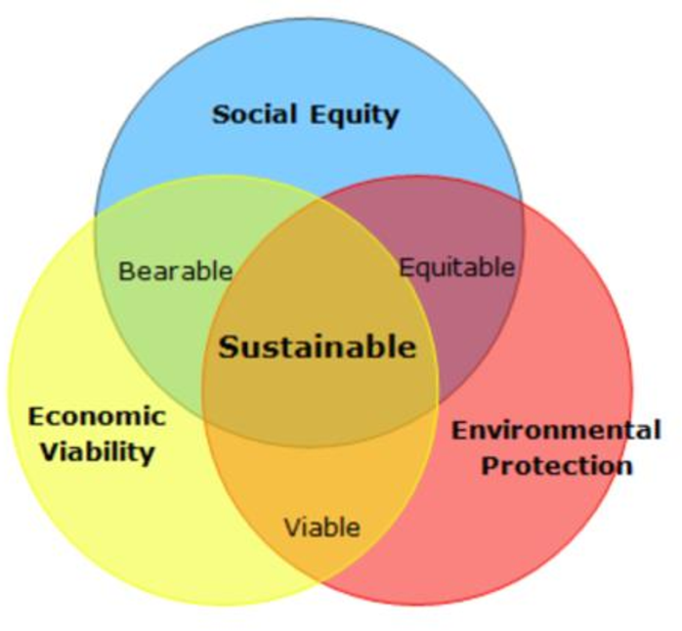
Elaborating harmonised tools and standards to implement low carbon initiatives on farms
What is sustainability?
“sustainable development (SD) generally refers to achieving a balance among the environmental, economic, and social pillars of sustainability”
(Murphy, 2012)
Need to assess indicators for each of the pillars
Drivers of farmers participation to agro-environmental schemes
Social: Age, education, successor…
Economic: Income factors
(Lastra-Bravo et al., 2015)

Slide 49

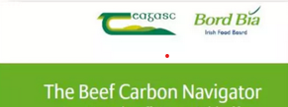



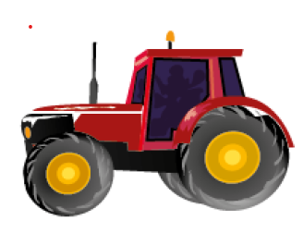

Elaborating harmonised tools and standards to implement low carbon initiatives on farms
Indicators to be implemented
Environmental indicators => tools to assess environmental impacts
Crops management
Herd management
Farm management

Slide 50
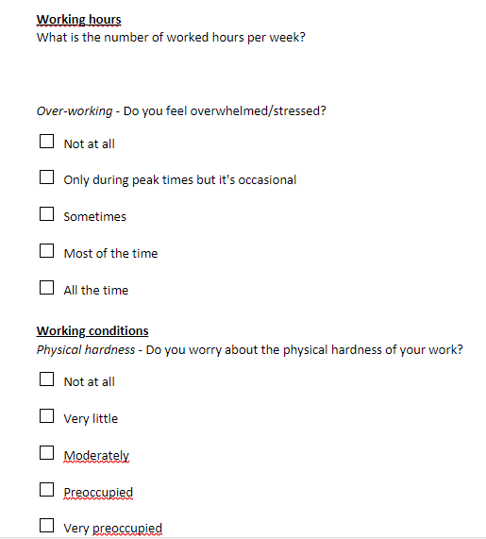
Elaborating harmonised tools and standards to implement low carbon initiatives on farms
Indicators to be implemented
Social indicators: figures/ multiple choice
=> some: already in environmental audit tools
Working hours
Working conditions
Services for territory
Farm continuity
Balance personal/professional life
Products quality
Employees on the farm
Animal Welfare

Slide 51
Elaborating harmonised tools and standards to implement low carbon initiatives on farms
Indicators to be implemented
Economic figures to be collected
Income per labour unit
Dependence on subsidies
Debt ratio
Exposure to price fluctuations
Transmissibility
Economic efficiency

Slide 52
Presentation of the LIFE Carbon Farming project
Objectives and partners
Elaborating harmonised tools and standards to implement low carbon initiatives on farms
  Sustainable assessment of farms
    A common MRV framework to certify low carbon projects on European farms
  Implementing low carbon projects in 700 mixed-crops livestock farms
  Elaborating reference costs of low carbon projects
  Implementing a result-based rewarding mechanism
  Implementing a low carbon network
  Inputs of the project for the Carbon Farming

Slide 53
Elaborating harmonised tools and standards to implement low carbon initiatives on farms
A common MRV framework to certify low carbon projects on European farms
Based on the French experience of the Label Bas Carbone with the Carbon Agri method and with adaptation to national contexts.
First basis of the Carbon Farming method:
Baseline scenario
Practices to be implemented
Monitoring of the low carbon projects
Calculation of the carbon gains
Verification
→ Carbon Farming Method will consider all alternatives to minimise MRV costs e.g. reducing data collection thanks to existing policy reporting requirements, facilitating advisers support and exchanges with farmers.

Slide 54
A common MRV framework to certify low carbon projects on European farms
Maximum duration: 5 years, revolving project for 5 years
Année 1
Année 2
Année 3
Année 4
Année 5
Année 6
Carbon audit
Baseline scenario = Carbon diagnostic specific to each farm

Slide 55

A common MRV framework to certify low carbon projects on European farms
GHG emissions
Carbon sequestration
Inputs
Pasture management,
Concentrates and fertilizers,
Legumes, Crops rotation
Herd management
Increasing productivity
Reducing number of unproductive animals
Cover crops
Fuel and electricity
No-till cultivation,
Power and equipment,
Working organization
Avoid bare soil
Feed
Feed efficiency,
Forage quality and yield
Agroforestry
Crops management & fertilization
Legume fodder crops,
Optimization of fertilizers uses
Manure management
Time spent in shed vs pasture,
Biogas production
Grassland management

Slide 56

A common MRV framework to certify low carbon projects on European farms
Maximum duration: 5 years, revolving project for 5 years
Année 1
Année 2
Année 3
Année 4
Année 5
Année 6
Carbon audit
Baseline scenario = Carbon diagnostic specific to each farm
Carbon plan and
simulation to assess carbon gain
Building of an action plan, choice of practices, objectives and carbon gains

Slide 57

A common MRV framework to certify low carbon projects on European farms
Maximum duration: 5 years, revolving project for 5 years
Technical visit
Technical visit
Année 1
Année 2
Année 3
Année 4
Année 5
Année 6
Carbon audit
Midterm control
Baseline scenario = Carbon diagnostic specific to each farm
Carbon plan and
simulation to assess carbon gain
Assessment of practices put in place
Building of an action plan, choice of practices, objectives and carbon gains

Slide 58

A common MRV framework to certify low carbon projects on European farms
Maximum duration: 5 years, revolving project for 5 years
Technical visit
Technical visit
Année 1
Année 2
Année 3
Année 4
Année 5
Année 6
Carbon audit
Midterm control
Final diagnostic
Calculation of the carbon gains
Baseline scenario = Carbon diagnostic specific to each farm
Carbon plan and
simulation to assess carbon gain
Assessment of practices put in place
Carbon audit and assessment of the implementation of practices, calculation of the carbon gains compared to year 1
Building of an action plan, choice of practices, objectives and carbon gains

Slide 59
A common MRV framework to certify low carbon projects on European farms
Maximum duration: 5 years, revolving project for 5 years
Technical visit
Technical visit
Verification audit by an independant auditor
Année 1
Année 2
Année 3
Année 4
Année 5
Année 6
Carbon audit
Midterm control
Final diagnostic
Baseline scenario = Carbon diagnostic specific to each farm
Carbon plan and
simulation to assess carbon gain
Assessment of practices put in place
Carbon audit and assessment of the implementation of practices, calculation of the carbon gains compared to year 1
Building of an action plan, choice of practices, objectives and carbon gains

Slide 60
A common MRV framework to certify low carbon projects on European farms
Maximum duration: 5 years, revolving project for 5 years
Technical visit
Technical visit
Verification audit by an independant auditor
Année 1
Année 2
Année 3
Année 4
Année 5
Année 6
Recognition of carbon credits
Carbon audit
Midterm control
Final diagnostic
Baseline scenario = Carbon diagnostic specific to each farm
Carbon plan and
simulation to assess carbon gain
Assessment of practices put in place
Carbon audit and assessment of the implementation of practices, calculation of the carbon gains compared to year 1
Building of an action plan, choice of practices, objectives and carbon gains

Slide 61
Presentation of the LIFE Carbon Farming project
Objectives and partners
Elaborating harmonised tools and standards to implement low carbon initiatives on farms
  Sustainable assessment of farms
    A common MRV framework to certify low carbon projects on European farms
  Implementing low carbon projects in 700 mixed-crops livestock farms
  Elaborating reference costs of low carbon projects
  Implementing a result-based rewarding mechanism
  Implementing a low carbon network
  Inputs of the project for the Carbon Farming

Slide 62
Implementing low carbon projects in 700 mixed-crops livestock farms
Maximum duration: 5 years, revolving project for 5 years
Farm’s recruitment
Project validation
Technical visit
Technical visit
Verification audit by an independant auditor
Année 1
Année 2
Année 3
Année 4
Année 5
Année 6
Recognition of carbon credits
Midterm control
Final diagnostic
Farm carbon diagnostic
Carbon plan and
simulation to assess carbon gain
Assessment of practices put in place
Carbon audit and assessment of the implementation of practices, calculation of the carbon gains compared to year 1
Building of an action plan, choice of practices, objectives and carbon gains

Slide 63

Focus on the first's years :
Recruitment :
          Phone call
          Partnership ( most of them are dairy industries)
          Other greenhouse gas reduction program
Diagnostic :
          Sending an email to the producers with the description of the meeting and asking them to send the documents
          Going at farm - and making the CAP’2ER
          Make the restitution if possible and try to start talking about the different ways of reduction
          Carbon plan and budget :
          A balance between your knowledge and the projects of the breeders and other advisers !

Slide 64
Benefits :
Technical visit :
          Carried out by one of our specialized advisers on a theme or another organization chosen by the breeder
Farmer benefits :
          « Know where our farm is » -> Knowledge
          “ It's interesting to know that our projects are going in the right direction” -> Validation

Slide 65
Implementing low carbon projects in 700 mixed-crops livestock farms
Maximum duration: 5 years, revolving project for 5 years
Farm’s recruitment
Project validation
Technical visit
Technical visit
Verification audit by an independant auditor
Année 1
Année 2
Année 3
Année 4
Année 5
Année 6
Recognition of carbon credits
Carbon audit
Midterm control
Final diagnostic
Farm carbon diagnostic
Carbon plan and
simulation to assess carbon gain
Assessment of practices put in place
Carbon audit and assessment of the implementation of practices, calculation of the carbon gains compared to year 1
Building of an action plan, choice of practices, objectives and carbon gains

Slide 66

How to manage the Knowledge transfer in the Life Carbon Farming project?
Knowledge transfer as "the process through which one unit (e.g., group, department, or division) is affected by the experience of another
Argote & Ingram (2000)
This process allows research results, discoveries, scientific findings, intellectual property (IP), technology, data and knowhow to flow between different stakeholders:
from universities and research institutions to industry or governmental institutions, generating economic value and industry development.

Slide 67

How to manage the Knowledge transfer in the Life Carbon Farming project?
Researcher
Advisor, technitians, farmers
Training
Network with policymakers, consumers, value chain, ecc.
Researchers, Advisor

Slide 68








How to manage the Knowledge transfer in the Life Carbon Farming project?
CREA
Advisors
Training kit which describe environmental issues in beef and dairy production, methodology to assess environmental impacts, the mitigation strategies, the gain permitted by each one, MRV mechanism……..
2. Organization of advisers training course with the aim to show the CARBON FARMING project, information n climate change, environmental tools, production systems, environmental impact of dairy and beef farms, mitigation techniques to reduce GHG emissions

Slide 69
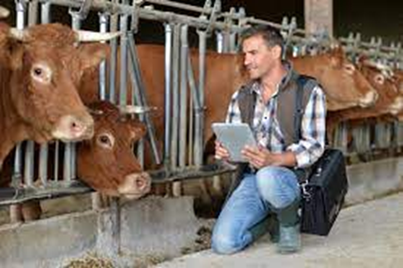
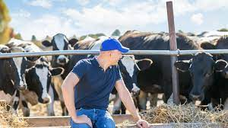
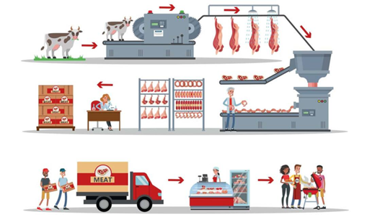
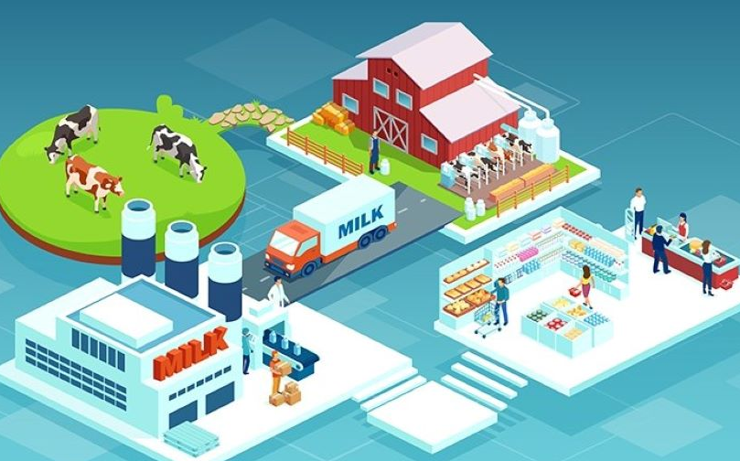
How to manage the Knowledge transfer in the Life Carbon Farming project?
beef farmers
dairy farmers
Advisor+ CREA
organization of training sessions (courses, workhop, farm’s open day, farners network)
whole beef and dairy value chain
to promote the Italian CARBON FARMING action plans and the approach to environmental sustainability (tool, MRV process, funding mechanism) developed in the LIFE CARBON FARMING project,
to improve the continuous exchange of information, practical knowledge and innovative solutions for a “low carbon beef and dairy production”.

Slide 70
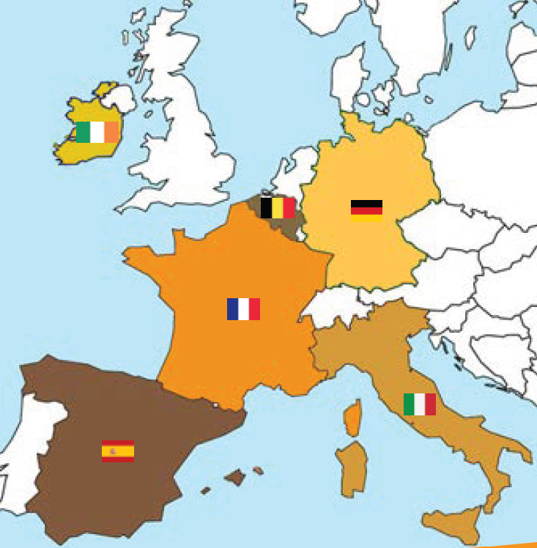
Implementing low carbon projects in 700 mixed-crops livestock farms
Objective to involve 700 farms in the project
Trainings of advisors carried out or planned
Initial carbon audits and carbon plan on progress
40
40
15
406
61
138

Slide 71
Presentation of the LIFE Carbon Farming project
Objectives and partners
Elaborating harmonised tools and standards to implement low carbon initiatives on farms
  Sustainable assessment of farms
    A common MRV framework to certify low carbon projects on European farms
  Implementing low carbon projects in 700 mixed-crops livestock farms
  Elaborating reference costs of low carbon projects
  Implementing a result-based rewarding mechanism
  Implementing a low carbon network
  Inputs of the project for the Carbon Farming

Slide 72
Elaborating reference costs of low carbon projects
Objectives:
Private administrative costs referential
Technical costs referential
Marginal abatement cost curves
- Reduction evaluation : the volume of GHG emissions/carbon sequestration saved over the project lifetime (5 years)
- The sum of private admin and technical costs will permit to elaborate an abatement cost referential in €/t CO2 reduction

Slide 73
Presentation of the LIFE Carbon Farming project
Objectives and partners
Elaborating harmonised tools and standards to implement low carbon initiatives on farms
  Sustainable assessment of farms
    A common MRV framework to certify low carbon projects on European farms
  Implementing low carbon projects in 700 mixed-crops livestock farms
  Elaborating reference costs of low carbon projects
  Implementing a result-based rewarding mechanism
  Implementing a low carbon network
  Inputs of the project for the Carbon Farming

Slide 74
Why it is important to discuss the project with public authorities.
1. This project needs recognition from the administration at several levels:
Recognition of BAT calculation methodologies;
Avoidance of double counting for the same practices;
Possible inclusion of improvements in inventories
Avoid greenwashing
2. Developing incentives to reduce the carbon impact of the land sector
3. Without the recognition of the administration, it will be impossible for small and medium sized farmers to engage in improving their practices beyond what is legally required.

Slide 75
Do not limit the European carbon certification framework to carbon removals
Carbon sinks, but also GHG sources as prescribed in IPCC guidelines
Payments on results are a solution to ensure the environmental impact of funding
Include indirect emissions in the scheme
It is essential to consider N2O and CH4 emissions:
  Certify only those projects that have no negative impact on N2O and CH4 emissions or;
  Certify net sequestration (carbon sequestration minus any increase in N2O and CH4 emissions)
Deal with carbon sinks, emission reductions and indirect emissions within the same framework BUT to count them separately
Deal to several certifications could discourage from focusing on both carbon sequestration and emissions reductions"

Slide 76
Ensure strong environmental integrity
The labelled practices they must not lead to negative effects on other environmental issues
To back up the calculation of the carbon impact with indicators for monitoring other issues.
This integration should be discussed with stakeholders and the scientific community to validate together the choices and keep in mind European objectives.

Slide 77
Governance: a common framework for high quality national and local tools
Methodologies used should combine the accounting or modeling part and MRV rules.
If all projects do not have the same MRV rules with the same robustness and transparency, there would be a risk of competitive distortion
1) The CE defines a list of credible and robust existing standards.
2) The CE defines common MRV rules but allows for multiple methods or standards.
3) The CE defines a common and single carbon standard with its own specific methodologies, using common accounting rules and scientific models.

Slide 78
Exchanges with the authorities in Spain about the LIFE Carbon Farming project
We have contacted MAPA. They are very interested in the matter, although for now they are more clear about the part concerning the C fixation.
Doubts about the recognition of the methodology ( procedures usually done internally or with agencies attached to the ministry)
MITECO: they have been contacted. They told us that they are interested in this issue and at the time of the application they signed a letter of support.

Slide 79

Implementing a result-based rewarding mechanism
A
Contract between farmers, project developers and aggregator
A
Farms – Sample 1
A
Project developer
Technical supervision
A
A
FCAA – France Carbon Agri
A
Farms – Sample 2
B
Project developer
Technical supervision
Euros
B
Buyers : banks, companies like Lidl, restaurant chains
B
B
Tons CO2
Contract between aggregator and buyers

Slide 80
Implementing a result-based rewarding mechanism
FCAA = aggregator for the 700 farms of the project :
Certification of the 700 farms with the method built in action C.1.
Studying all the possible sources of funding and the carbon market
Survey built to solicit buyers and better understand their needs and if they would be interested in funding low carbon projects in the frame of the LIFE Carbon Farming
Finding fundings and adding value to certified carbon gains

Slide 81
Presentation of the LIFE Carbon Farming project
Objectives and partners
Elaborating harmonised tools and standards to implement low carbon initiatives on farms
  Sustainable assessment of farms
    A common MRV framework to certify low carbon projects on European farms
  Implementing low carbon projects in 700 mixed-crops livestock farms
  Elaborating reference costs of low carbon projects
  Implementing a result-based rewarding mechanism
  Implementing a low carbon network
  Inputs of the project for the Carbon Farming

Slide 82
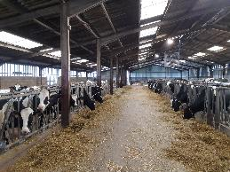
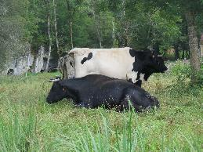
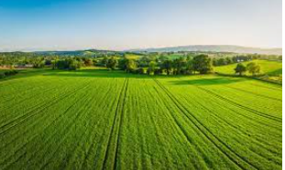
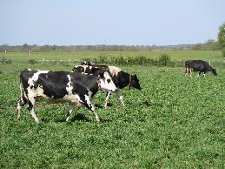
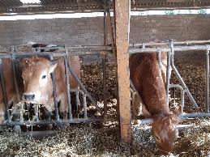
Implementing a low carbon network
Promoting exchanges and knowledge sharing on low carbon initiatives on national and European scales to have a dynamic between the project participants
Objectives :
6 Three-day European workshops with visits on farms
11 two-day national workshops with visits on farms

Slide 83
Presentation of the LIFE Carbon Farming project
Objectives and partners
Elaborating harmonised tools and standards to implement low carbon initiatives on farms
  Sustainable assessment of farms
    A common MRV framework to certify low carbon projects on European farms
  Implementing low carbon projects in 700 mixed-crops livestock farms
  Elaborating reference costs of low carbon projects
  Implementing a result-based rewarding mechanism
  Implementing a low carbon network
  Inputs of the project for the Carbon Farming

Slide 84
Inputs of the project for the Carbon Farming
Tools harmonisation and creation of a common method
Implementation on European scale – concrete implementation
Proposing certified emissions reudctions for carbon credits or other types of fundings
Bringing elements on implementation costs for the farmer and administrative costs (MRV) → finding a balance between certification quality and costs
Communication of the results to the agricultural sector
Feeding the discussion on Carbon Farming with public authorities
Creating links between farmers and buyers

Slide 85
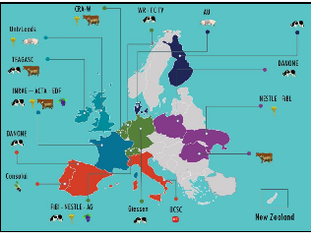
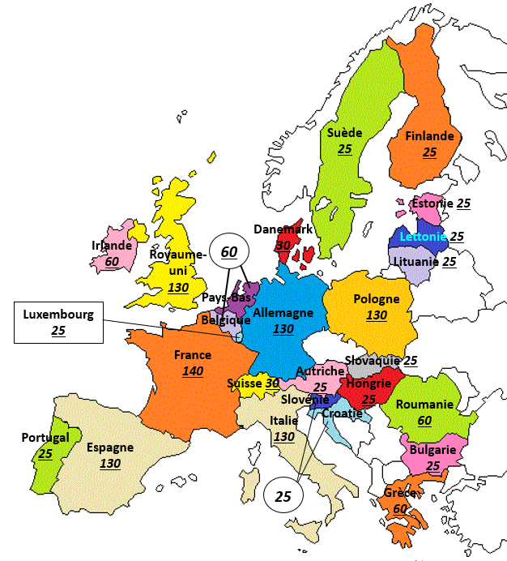
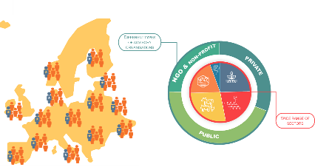



LIFE CARBON FARMING interconnected with other EU projects
Raising awareness on agriculture and climate
Involving farmers and advisers in climate transition
Harmonized tools and standards at EU scale (GHG Emissions & Carbon removals)
Co-innovation and demonstration actions in farms
Upscaling carbon rewarding mechanism for farmers
H2020 CLIENFARMS– 2022/2025
H2020 Climate Farm Demo – 2022/2029
H2020 Climate Smart Advisors 2023/2030
27 countries
72 partners
1500 advisors
12 countries
33 partners
1 200 farms
ILVO
28 countries
80 partners
1 500 farms

Slide 86
LIFE CARBON FARMING wokshop
Testimonies on Carbon Farming implementation

Slide 87


Rewarding actors fighting climate change
at the local level
French Ministry of Energy transition

Slide 88
Agenda
Context
Functioning of the Label
Methods
Projects
Financing
Notes:
Je vais vous parler du Label Bas Carbone et donc nous allons commencer par poser le contexte afin d’aborder le fonctionnement du LBC dans son ensemble.
Nous verrons ensuite comment déposer des émthodes et les différentes méthodes existantes.
Nous verrons également le devenir d’un projet et aborderons enfin le financement de ces derniers.

Slide 89

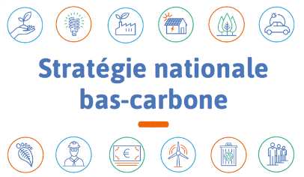
I. Context
The label was developed in 2019.
Current climate change mitigation actions are insufficient to achieve the 1.5-degree target.
  Need to support emission reduction and carbon sequestration efforts, especially in diffuse sectors (agriculture, forestry, transport, building, recycling/reuse…)
Contribution to the implementation of the National Low-Carbon Strategy by :
  Promoting the emergence of local actions that benefit the climate and the dissemination of good practices
  Mobilizing innovative financing for climate action from various stakeholders (companies, public bodies, citizens…)
Certification tool that guarantees environmental quality
  Additional emission reductions and carbon removals
  Co-benefits (biodiversity, social…) neutral or positive
Notes:
Contexte du label ;
Le label a été élaboré par le ministère de la Transition écologique et solidaire, en lien avec le ministère de l'Agriculture et de l'Alimentation et de nombreux autres partenaires.
A cette époque et aujourd’hui encore les actions restent insuffisante pour atteindre la cible de 1,5°. Il est ainsi important d’encourager les réductions d’émissions et de séquestration dans divers secteurs : comme l’agriculture, des transports.
Comme Zoé la présenter avant c’est un outils pour répondre à la stratégie nationale bas carbone en encourageant les actions locales et favorisant la dissémination des bonnes pratiques. Cela passe notamment par mobiliser des systèmes de financements assez innovants.
C’est une certification qui garanti une certaine garantie environnementale notamment à travers les co-bénéfices et l’additionnalité (il faut que les porteurs de projet prouvent qu’ils émettront moins de carbone grâce au LBC)

Slide 90
II. Functioning of the label
Certified emission reductions
What is called “réductions d’émissions” in the LBC = emissions reductions and CO2 absorptions, indistinctively
Emission reduction are monitored accurately (discounts may apply) and verified by an independent and qualified auditor, according to modalities specified in the method.
Additionality is assessed relative to a baseline scenario, determined in the method :
  Likely situation in the absence of labelling
  Regulatory requirements and common practice
  Incentives provided by other instruments than the label
→ Only emission reductions that go beyond the baseline scenario are recognized
→ To ensure real additionality, a specific baseline scenario should be used whenever possible: generic baseline scenarios are only possible in duly justified cases, discounts are applied to avoid over-estimations
Baseline Scenario
Net emissions
Project scenario
Accreditation Period
Time
Reductions taken into account by the low carbon label
Indirect emissions reductions
Direct emissions reductions
Reductions
achieved
Checked afterwards
Anticipated
Reductions
Checked upstream
Notes:
Pour rentrer un peu plus dans le fonctionnement d’un projet bas carbone et dans les réductions d’émissions,
Les réductions d’émissions se basent sur un scénario de référence, indiqué ici en baseline scenario. Scénario qui aurait eu lieu si le projet labellisé Label Bas Carbone n’avait pas eu lieu. Le porteur de projet établi également un scénario de projet.
C’est la différence entre ces 2 scénarios (en vert sur le schéma) qui permet de déterminer les réductions d’émissions qui vont être labellisées.
C’est dans ce sens que les porteurs de projets doivent prouver l’additionnalité du scénario de projet et donc prouver qu’il y a une réduction des émissions par rapport au scénario de référence, ils doivent démontrer que grâce au label il y a une réduction des émissions plus importante que sans le label.
Il est également important de prouver l’additionnalité économique : c’est-à-dire que le projet n’aurai pas pu avoir lieu sans les subventions du LBC.
Dans les émissions on compte les émissions indirect (comme par exemple celles liés au transport qui ont lieu en aval et en amont de l’exploitation) et les émissions direct (qui ont lieu directement sur l’exploitation par exemple l’émission entérique des bovins, liés à leur digestion). Ces émissions directes peuvent être labellisées à la fin du projet : ce sont les émissions ex post ou alors en anticipé, ce sont les émissions ex-ante.
Ces réductions d’émissions sont vérifier par un auditeur qualifié et indépendant du porteur de projet.

Slide 91








II. Functioning of the label
①
Stakeholders and experts
National standard (November 2018)
Sectoral methodologies
Local projects
Emissions reductions
Specifies by decree
Develop
②
③
Approves
Citizens, companies or public bodies
④
Notification and project submission
tCO2
Finance
Labels
tCO2
⑤
tCO2
tCO2
⑦
Verifies
tCO2
Recognizes
⑧
tCO2
Receive
⑨
⑥
Independant auditor financed by the project holder
Verifies the conformity
The scheme is open to all types of investors (public or private, national or foreign) but projects must be located in France (mainland or oversea)
Notes:
Fonctionnent du LBC :
1- Référentiel du Label Bas Carbone : Décret et arrêté qui fixe le cadre du label établit par le MTE
2- En veillant à bien répondre à ce cadre des experts et des acteurs des différentes filières vont développer des méthodes bien spécifiques à leurs secteurs.
3- Après différents échanges et un véritable processus, la méthode est (ou non) approuvée
4 – En répondant à ces méthodes, des acteurs du territoires vont ainsi notifié auprès de leur direction régionale de l’environnement, l’aménagement et du logement (DREAL). Ce sont les porteurs de projets, ils peuvent porté des projets individuels (par exemple le propriétaire d’une exploitation agricole) ou bien des projets collectifs (projets similaires). Le projet peut etre porté par la porteur de projet ou par un mandataire (c’est lui qui est responsable du projet devant l’autorité)
5- Ce sont ensuite les DREAL qui labellise le projet, en fonction de si ce dernier répond bien aux exigences de la méthode et du label
6- Afin de vérifier et de contrôler l’exactitude des informations, des documents demandés dans le projet, un auditeur, indépendant du chef du projet, va contrôler la conformité du projet.
7-8- Ainsi les DREAL vont vérifier les réductions d’émissions du projets et les reconnaît afin qu’en
9- Les financeurs reçoivent des réductions d’émissions ce qui va leur permettre de compenser leurs émissions de carbone.

Slide 92
III. Methodologies
Intention of notice to developp a new method for the LBC : by an online formular filled in by the method developer
Response by the DGEC to this notice (in favor or not)
Submission of a draft method by the method developer
Exchanges between the method developer and the DGEC and eventually other directions
Public consultation (3 weeks)
Consultation of the Scientific and Technical Group
Approval or refusal of the method
Potential modifications of the draft method
Publication of the method
How to approve a new method ?
①
②
③
④
⑤
⑥
⑦
⑧
⑨
Notes:
Nous allons maintenant rentrer un peu plus dans le détails de l’approbation d’une nouvelle méthode, le processus est détaillé ici sur cette diapositive.
1 – Intention de notification : à travers un formulaire sur notre site internet, ou bien un mail, (ou bien lors de Webinaire), nous sommes mis au courant qu’un acteur de la filière, (que l(on appellera porteur de méthode) travaille au développement d’une méthode.
2- Un peu plus tard la DGEC peu donc répondre si avec le peu d’élément (en général l’intention de notification fait seulement quelque ligne, une page et n’est pas très détaillée). La DGEC indique si elle se positionne pour le développement d’une méthode ou non (au regard des autres méthodes existantes, du nombre de tonnes que cela pourrai éventuellement labelliser…).
3- Suite à cela, les porteurs de méthodes travaillent au développement de la méthode (parfois en collaboration avec d’autres acteurs de la filière qui souhaitaient également développé une méthode sur ce levier d’action). Une fois une première version de la méthode rédigée, les porteurs de méthode dépose cette méthode auprès de la DGEC
4 – La DGEC la relit et l’envoie à d’autres direction (comme celle de la biodiversité et de l’eau), d’autres services de l’administration centrale afin de récolter un maximum d’avis sur cette méthode. L’équipe du LBC se charge de vérifier que la méthode rentre bien dans le cadre du décret et de l’arrêté du LBC. Une fois toutes les remarques des différents services, et personnes de l’administration compilés dans un document cette version est renvoyés au porteurs de méthodes. Il va ensuite la modifier, puis nous la renvoyer, afin que la méthode soit réexaminé, cela peut faire de nombreux échanges.
5- Une fois la méthode que l’on considère dans sa version finale, elle sera soumise à la consultation du public, c’est-à-dire que pendant 3semaines, elle sera accessible et n’importe qui (particulier, ONG…) pourront faire des remarques sur cette méthode.
6- Une fois cette consultation, la méthode passe entre les mains d’experts à travers un groupe scientifique et technique
7- A la suite de cela il y a çà nouveau des potentiels modifications de la méthode par le porteur de méthode.
8- La méthode est ensuite approuvée ou refusée.
9- Si elle est approuvée, elle est alors publiée.

Slide 93


















III. Methodologies
Composition of the scientific and technical group
Scientific and Technical Group
State-owned public institutions
Experts of the civil society
Qualified personality
Notes:
Le groupe scientifique et technique est composée de nombreuses institutions :
Etablissements publics de l’Etat :
ADEME : Agence de l’Environnement et de la Maîtrise de l’Energie, qui participe à la mise en œuvre des politiques publiques en matière de transitions (énergie, environnement, développement durable)
CEREMA : Centre d’étude et d’expertise sur les risques, l’environnement, la mobilité et l’aménagement. Il accompagne l’État et les collectivités territoriales pour l’élaboration, le déploiement et l’évaluation de politiques publiques d’aménagement et de transport.
CSTB : centre scientifique et technique du bâtiment
Conservatoire du littoral : protection du littoral
Université Gustave Eiffel : une université
INRAE: Institut National de la Recherche pour l’Agriculture, l’Alimentation et l’Environnement
CNPF : Centre National de la Propriété Forestière
France AgriMer : Etablissement national des produits de l’agriculture et de la mer
ONF : Office Nationale des Forêts
IGN : Institut national de l’information géographique et forestière, produit des cartes, des données et services géographiques.
Experts de la société civile :
FNE : France Nature Environnement
I4CE : Institute for Climate Economics
GERES : réseau solidarité climat
CITEPA : données expertise air et climat
FCBA : institut technique chargé des secteurs de la forêt, de la cellulose, du bois construction et de l’ameublement.
Personnalité qualifiée : Jean-François Soussana, membre du HCC. Le HC est une instance consultative indépendante française crée en 2018, placé près du premier ministre. Ce sont des experts scientifiques, techniques et économiques dans le domaine des sciences du climat et de la réduction des GES.

Slide 94
III. Methodologies
Each methodology
    Specifies eligibility criteria of the projects
    Specifies how additionality is demonstrated
    Evaluates the cobenefits (negative and postive impacts)
    Takes into account the risk of non-permanence and of release of carbon, by applying discounts
    Determines the procedures to verify the emissions reductions
    Specifies the procedures to monitor the indicators
Notes:
Chaque méthode doit respecter des critères bien spécifiques :
1- Elle doit préciser les critères d’éligibilité : quel critère doit respecter le porteur de projet pour pouvoir déposer un projet pour cette méthode (par exemple avoir un atelier bovin lait, respecter les apports d’azote de 170kg/ha…)
2- Spécifier comment l’additionnalité est démontrée, cad montrer en quoi le projet fait mieux que son scénario normal
3- Evaluer les co-bénéfices, différents types socioéconomiques, biodiversité, eau… Il faut les quantifier
4- Déterminer les éventuels rabais, en effet pour chaque méthode, afin de limiter les surestimation de réductions d’émissions, des rabais peuvent être appliquer notamment pour les risques de non permanence, le risque de non-permanence ; c’est-à-dire le risque d’émissions de carbone imprévues : tempête, incendie, attaques sanitaires, dépérissement… Dans ce cas les rabais sont généralement de 10%
5- Déterminer la procédure de vérification des réductions d’émissions, donc la procédure d’audit effectuée à la fin du projet où au moment d’attribution des RE.
6- Spécifier la procédure de suivi des différents indicateurs et des données à suivre, leur fréquence…

Slide 95




III. Methodologies
11 methodologies have been approved
Forest :
Afforestation
Reforestation after fire, storm or sanitary disease
Saplings selection
Agriculture :
Orchards plantation
Sustainable management of hedges
CarbonAgri (livestock-crop farming)
SOBAC (input management)
Ecomethane (cattle feeding)
Field crops
Transport :
use of local co-working spaces
Building sector :
Reuse of building materials in rehabilitation operations
Notes:
A l’héure d’aujourd’hui 11 méthodes ont été approuvés :
En forêt : Boisement, et reboisement après une forêt dégradée que ce soit par le feu, une tempête ou une crise sanitaire, balivage
En Agriculture : Plantation de verger, gestion durable des haies, CarbonAgri (gestion globale d’une exploitation de polyculture élevage), Sobac (diminution des intrants), Ecométhane (changement de la ration alimentaire des bovins en vue de diminuer le méthane entérique), Grandes Cultures (gestion plus durable des cultures)
Transport : tiers lieu (diminution des émissions à travers la baisse d’utilisation de carburant)
Bâtiment : Rénovation

Slide 96


III. Methodologies
Methods under development
Methods under development
Agriculture: pig farming, agroforestry, winegrowing …
Forests: forestry with continuous cover …
Circular economy: recycling and reconditioning of electronic devices..
Wetlands: improved protection of mangroves, of seagrass…
Building: use of bio-based materials in new buildings…
Transport: freight transport…
Notes:
Des méthode en développement :
Agri : méthode porc
>Forêt :: développement des V3 forestière, et sylviculture à couvert continu
Economie circulaire
Zone humide : méthode herbier sur les littoraux, qui passe en GST mardi
Bâtiment : BBCA et valorisation du stockage carbone longue durée (utilisation du bois dans les constructions)
Transport de fret

Slide 97
III. Methodologies
Link between methods : overlapping levers
CarbonAgri (livestock-crop farming)
Hedges
Permanent pasture
Field Crops
Cattle buildings
Temporary pasture
SOBAC (input management)
Sustainable planting and management of hedges (any hedges owner)
Sustainable planting and management of hedges (Breeders)
Mineral and organic fertilizers production
Storage buildings
Reducing fertilizers use (both organic and mineral)
Reducing the use of crop protection products
Other crops (winegrowing, horticulture, …)
Other cattle leverage points
Power consumption
Ecomethane (cattle feeding)
Fabrication process of crop protection products
Pasture
Fodder from forage grass in the feed ration
Increase in fodder quality
Others leverage points about field crops
Other crops :
Orchards
Alfalfa and ALA rich seeds (flaxseeds, camelina seeds) in the cattle feed ration
Other feeding leverage points
Carbon storage in threes and soils
Orchards plantation
Notes:
Dans les méthodes agricoles, différents leviers d’action se recoupent dans les méthodes :
Carbo Agri la plus globale avec Polyculture élevage avec lait
Grandes cultures
SOBAC : réduction des intrants de manières générales mais pas que en GC (en viticulture aussi,…)
Ecomethane : réduction du méthane à travers l’apport d’ALA (acide alpha linolénique qui sont retrouvable dans les graines de lait et de cameline)
Haies : va dans les exploitations agricoles mais pas uniquement aussi pour tous les propriétaires de méthodes

Slide 98




IV. Projects
Notification
Deposit
Follow-up
Audit
Implementation
Verification of emission reductions
Instruction
Labelling
Awarding of emission reductions
12 months maximum
Duration of a project (specified in the methodology)
Since march 2022
Project Leader or Agent
Regional state administration - Prefects
Project Leader or Agent
Auditor
Regional state administration - Prefects
Project Financing
Collective project : agent who gathers all the individual sub-project holders
Individual project: agent or project leader
Notes:
Maintenant qu’on a vu les différentes méthodes, on va rentrer plus en détails dans la vie d’un projet :
1 Notification sur le site : contact du porteur de projet et infos générales, plus dans le détail
2 Dépôt du projet : 12mois maximum après la notification), possibilité de changer les membres du projet… Le projet peut etre porté par le porteur de projet lui-même ou par un mandataire qui devient le représentant du projet devant l’autorité.
la notification et le dépôt de projet se font via démarches simplifiées, cela permet de récolter toutes les informations en ligne
3 Instruction du projet par les directions régionales
4 Labellisation par les DREAL
5 6 Mise en place du projet et suivi du projet effectué par le porteur de projet, en cas de prohjet collectif le mandataire veille au bon suivi des différents indicateurs.
7 L’audit a lieu soit à la fin du projet (5ans) en cas de réductions d’émissions ex post, en cas de réductions d’émissions anticipées ex ante c’est 5ans après le début du projet mais els projets forêts durent 30ans
8 Les réductions d’émissions sont ensuite vérifiées par la dreal qui les réattribue aux différents financeurs
Le financement de projet peut intervenir tout le long du procédé.

Slide 99

IV. Projects : 357 labelled projects
357 labelled projects for around 1,4 M t_{eq}CO₂
17
16
31
8
11
65
19
34
80
23
42
10
Notes:
Aujourd’hui (les chiffres datent d’il y a une semaine) 308 projets labellisés pour près d’1,3Millions tonnes de CO2.

Slide 100











IV. Financing : a growing number of funders
Private :
The funder can contact the project developer at any moment :
At the start of the project development;
Once the project is labeled and displayed on the website;
Once the emissions reductions are verified.
Only direct financing : once the emission reductions are bought, they can not be transferred any more, but :
Some project developers may mandate a representative (“mandataire”) to take in charge the entire labelling process, including looking for funders.
A single intermediary can connect or aggregate funds from several individuals or legal entities who wish to participate in financing the project
Public :
« Emission reductions », once attributed to one funder, cannot be sold or exchanged in any way.
And many others …
Notes:
Le financeur peut contacter le développeur de projet à tout moment :Au début du développement du projet ;Une fois le projet labellisé et affiché sur le site web ;Une fois que les réductions d'émissions sont vérifiées.
Financement direct uniquement : une fois les réductions d'émissions achetées, elles ne peuvent plus être transférées, mais :Certains développeurs de projets peuvent mandater un mandataire (" proxy ") pour prendre en charge l'ensemble du processus de labellisation, y compris la recherche de financeurs. Un seul intermédiaire peut mettre en relation ou agréger les fonds de plusieurs personnes physiques ou morales qui souhaitent participer au financement du projet. Cela diffère avec un marché carbone où les crédits carbone varie et sont cessibles.
Les financeurs peuvent être publics ou privés.
Les financeurs devraient être de plus en plus nombreux car aujourd’hui les centrales à charbon qui ont rouvert sont obligés de compenser leurs émissions de carbone et c’est également le cas pour les compagnies aériennes et les vols internes ( en France le trafic aérien représentait 4,8millions de tonnes de CO2 en 2019)

Slide 101
V. Financing : Connect projects and funders
Projects
Funders
website of the Label
Intermediary
Notes:
Les financeurs et les porteurs de projets sont mis en lien grâce à notre site internet qui publie les différents projets, leurs réductions d’émissions ainsi que les co bénéfices associé (la note) cela permet aux entreprises qui voudrait par exemple financer des projets avec un impact positif sur la biodiversité de choisir un projet associé.
Point sur les intermédiaires :
Qu’est-ce qu’un intermédiaire et quel est son rôle ? Les bénéficiaires des réductions d’émissions, c’est-à-dire le porteur de projet ou les entités ayant apporté le financement du projet, peuvent apporter un financement direct ou via un intermédiaire unique. Cet intermédiaire met en relation plusieurs personnes ou des fonds provenant de plusieurs personnes qui souhaitent participer au financement du projet (par exemple financement participatif), mais n’est jamais bénéficiaire des réductions d’émissions reconnues. Le bénéficiaire est unique, c’est-à-dire qu’entre le porteur de projet et le financeur il ne peut y avoir qu’une seule autre personne dans la chaine contractuelle. Juridiquement, l'intermédiaire est un mandataire au sens du code civil, il représente le financeur ou le porteur de projet pour contractualiser avec l'un ou l'autre

Slide 102

Thank you !
https://label-bas-carbone.ecologie.gouv.fr/
Notes:
On a donc pu voir comment fonctionnait les méthodes, les projets et leurs financements, n’hésitez pas si vous avez des questions !

Slide 103
How to Involve Famers in Extension Projects: Setup and Recruitment
Donal O’Brien¹ and Martina Harrington²
Teagasc, Soils and Environment Research Centre, Johnstown Castle, Co. Wexford, Ireland
Teagasc, Advisory Office, Enniscorthy, Co. Wexford, Ireland
Carbon Farming Certification Workshop, Fondation Universitaire, Brussels, 25th January 2023

Slide 104

Background
Teagasc - Irish Agriculture and Food Development Authority
  National body, est. 1988
  Integrated advisory, education and research service
  Employ 1,200-1,300 staff
  State and industry funded
    (70%-75% exchequer)
Strategy Statement
  Improve competitiveness
  Support sustainable farming
  Enhance diversification

Slide 105










What does Teagasc Extension Programme offer farmers?
Training & Development
Specialist Advice
P2P Learning – Discussion groups
Industry & Media Networks
Management Tools – On & offline

Slide 106

Signpost Programme
Teagasc initiative to reduce carbon/greenhouse gas (GHG) emissions from Irish agriculture
  Supported by ministry and industry (co-ops, food processors)
Establish baseline GHG fluxes and carbon stocks
Accelerate uptake of climate actions across farming enterprises - Beef, Dairy, Sheep and Tillage
  Quantify and verify carbon/GHG savings
Carbon footprint
Biodiversity
Sustainability

Slide 107

Signpost Advisory Campaign
Signpost Farmers central to Signpost Advisory Campaign
Primary focus for our advisers and teachers
Tailored advice – Farm Sustainability Plan
Blended approach – traditional and digital
  Living labs – Measure and model C sequestration
Targeted communications

Slide 108


Signpost Programme - Future Beef Farms
Building on BETTER farm & LIFE BEEF CARBON initiative
  Improve efficiency while enhancing environmental performance
Cohort of Demonstration farms
  P2P learning central to success
Represent key characteristic of suckler beef farms in a region:
  Farm size and soil types
  Beef Breeds
  Production systems e.g., suckler calf to weanling, weanling to beef, fattening

Slide 109

Future Beef – Recruitment Process
Extensive selection process
Zoom meeting will all 12 regions – Regional managers, cattle advisors & education staff.
Explained:
  Future Beef & Carbon Projects
  The farmer profile required
  What the farmer could expect
  What we would provide the farmer with
Application form designed and emailed to all cattle advisors & industry funders

Slide 110

Future Beef – Recruitment Process
Large number of applications
Shortlisted within region
Remote meeting with applicants
36 farms visited
22 farms selected
From beginning building an awareness of the programme

Slide 111
Reasons Farmers Join Sustainability Projects
Want to future proof their family farm
  Improve resilience and long-term viability of their business
Understand the need for change – Require direction & support
Produce more from less, become more competitive…win: win
Decrease dependence on fossil fuels, chemicals, plastic etc…
Integrate science based solutions into their farming practices
Work in partnership with peers and extension team
  Innovate , Share the possible…to shape positive change

Slide 112
Thank You for YOUr ATTENTION
Questions?

Slide 113

FCAA
France Carbon Agri
  Implementing and funding collective result-based
  Low Carbon Farming projects
  LIFE CARBON FARMING workshop
  25th of January 2023
  Pierre RAYE – France Carbon Agri

Slide 114











FCAA : a pioneer initiative launched in 2019 by French farmers
FCAA : created by famers organisation
Mission :: «Supporting agroecological transition via the funding of farming practices reducing the carbon footprint of agriculture. »
Key values :
Implementing the best scientific standards to guarantee the impact of the projects.
Securing the traceability of carbon credits.
Ensuring the transparency of the value chain.
Maximising the financial return to farmers.

Slide 115




FCAA : a platform to make the carbon farming project possible
Farmers
Project developers
& advice companies
Contributing
companies
Certification Authority
(Ministry of environment)

Slide 116


Supporting & Securing the certification of Carbon Farming projects
Farmers recruitment
T 0 Farm Carbon footprint
5 Year Action Plan
Notification to the Certification Authority
Final Audit
3rd Auditor
Certification
Final Farmer Payment
Mid Term Audit
1st Farmer Payment
Year 1
Year 2
Year 3
Year 4
Year 5
Farmer
FCAA support the Project Developer to implement the best practices and ensure a proper monitoring of the projects.
Company
FCAA ensure the promotion of the projects
to find contributing companies.

Slide 117



FCAA : a trusted third party between farmers and contributing companies
40€/T CO2 eq
FCAA-Farmer
- Project developer -
FCAA
- Contributing company -
Each party remuneration
Farmer commitment to implement the action plan.
Project developer commitment to assist technically the farmer.
FCAA commitment to monitor the certification and funding of the project.
Carbon credit volume & price.
Carbon farming specifications :
  Localisation
  Cobenefits
  Others…
FCAA commitment to ensure the implementation of the project.
“Taylor Made” services : communication, engineering …
32€
Project developer
Farmer
FCAA
5€
3€

Slide 118

More than 3 000 farmers committed with FCAA
Nb of farms committed
T Carbon credit
Call for Projects 1
(2020)
Call for Projects 2
(2021)
Call for Projects 3
(2022)

Slide 119




Example of the 1st call for projects
FARMS
NUMBER
301
NEW PRACTICES
NUMBER
per farm
4.5
AVERAGE POTENTIAL CARBON GAIN
T CO₂/farm
459
138 000
tons of CO2 avoided over 2020-2025
How ?
Land management
Hedges plantation, agroforestry, grasslands management, legumes seedling, reduction of fertilization
Feed
Improving forage quality, more grazing and less concentrates. Protein autonomy.
Energy and buildings
Reduction of fuel and electricity consumption. Biogas and pit cover
Herd management
Animal health, housing and rearing of heifers
453
284
153
465
Number of levers per theme for the 300 farms
11

Slide 120







And many Cobenefits that are monitored
Contribution to biodiversity
Increase the surface or linear areas of meadows, hedges, isolated trees, copses, ponds, etc.
Fighting deforestation
Water quality
Substitution of soya with local co-products or fodder
Reduction in the amount of nitrogen lost to water
Energy Production
Air quality
Production of renewable energy through methanisation, photovoltaic panels or wood energy
Reduction in the amount of nitrogen lost to the air
Area of plant cover
Limit erosion, nitrogen leaching, improve soil fertility and increase carbon storage through soil cover
The project must prevent any significant negative environmental or socio-economic impacts
9

Slide 121

A growing corporate interest to contribute to climate action…..
Share of listed companies committed to a Net Zero target
Companies
Carbon Strategy
Voluntary Carbon Markets
in 2021
1. Inventory
493 Mt CO2 credits traded
X 2,6 VS 2020
2. Targets
World
2 Bn $ credits traded
X 3,8 VS 2020
3. Reducing
4. Offset
6,2 Mt CO2 credits traded
+ 15 % VS 2020
France
5. Communicate
64 M € credits traded
Source Ecoact

Slide 122





But a crucial need to relocate carbon offsetting in Europe to finance the transition to low carbon farming
Strong price gap between Europe & Extra Europe projects.
Need to value local/European low carbon projects thanks to :
  Robust Certification Standards.
  Cobenefits valorisation.
  Good technical information.
  Positive communication.
  Need of a European regulation on Carbon Certification that encompasses carbon storage & reduction of carbon emissions.
French voluntary carbon offsetting
Market share / certification scheme
Verra
Gold Standard
CDM
French
LBC
Other

Slide 123

Thank you for your attention and at your disposal
Email : pierre.raye@fcaa.fr
Phone : 00 33 6 35 36 57 76
Website : https://france-carbon-agri.fr/
17

Slide 124
LIFE CARBON FARMING wokshop
→ Workshop sessions
  How to build an efficient monitoring and certification process for answering project developers, carbon buyers and public body’s needs?
  What funding mechanisms to support low carbon projects?

Slide 125
LIFE CARBON FARMING wokshop
→ Workshop sessions
  How to build an efficient monitoring and certification process for answering project developers, carbon buyers and public body’s needs?
  What funding mechanisms to support low carbon projects?

Slide 126
How to build an efficient monitoring and certification process?
Contractualisation process with:
- aggregator, farmer and project developers
- buyers / funders and aggregator
Aggregator
Communication to farmers, advisors
Farmers’ recruitment
Aggregator and project developers
Assessing the economic impact of the low carbon projet
Partial budgeting
Project developers - advisors
Building a certification framework
Certifier authority
Validation of the files
Labeling of the project
Certifier authority
Validating methods to assess carbon gains
Certifier authority
Initial carbon audit
Building a carbon action plan
Simulation and assessment of the potential carbon gain
Project developers - advisors
Files control
Collective project reporting
Aggregator
Communication and sales to credits carbon buyers and potential funders
Aggregator

Slide 127
How to build an efficient monitoring and certification process?
Final carbon audit
Practices implementation control
Real carbon gain evaluation
Project developers - advisors
2 technical visits to monitor the project
Project developers - advisors
External verification Independant auditor
Payment by the carbon credits buyers / funders
Aggregator
Mid-term control on farm of the practices implementation
Project developers - advisors
Control and aggregation for the final certification report
Aggregator
Recognition of carbon credits
Certifier authority
Payment to farmers, project developers and aggregator
Aggregator

Slide 128
How to build an efficient monitoring and certification process?
Brainstorming session:
→ What are the risk factors and the success factors for the different steps of the certification process?

Slide 129
How to build an efficient monitoring and certification process? – Workshop restitution
How to mobilize farmers ?
How to keep informed advisors ?
It’s a win win project : GHG / biodiversity / economic …
Contractualisation
Baseline / target
Positive communication
Methods / standardisation
Administrative work
5 years: it’s long for advisors / farmers, but short for policy makers
A lot of steps

Slide 130
How to build an efficient monitoring and certification process? – Workshop restitution
Risk factors
Success factors
Definition of EU CRC framework taking too long
Strong discrepancies across methods and scientific standards
Double counting
Time and cost of monitoring, data robustness
Low price of carbon
Carbon tunnel vision
Greenwashing
Good definition of common criteria (not necessarily same methodology for everybody)
Transparency on methology validation
Communication and education onlow carbon projects
Technical advisory (very important)
Robust cost/gain projections for farmers
Finding the right price for buyers and farmers
Measure co-benefits
General comments:
Defining a common vocabulary to talk about this topic is very important – there are language discrepancies across countries (ex: certifyer authority vs accreditor
Valid both for company communication and stakeholders involved in certification process

Slide 131
How to build an efficient monitoring and certification process? – Workshop restitution
Responsibility of member states to support farmers, being careful of time-consuming and expensive approachs, lot of documents asked to the farmers, facilitate controls
Objective : Getting carbon credit or most of all certification of the farmer’s practices to avoid greenwashing
Method: having an objective framework common to member states with same kinds of calculation, involving national administration and finding a balance between having method adapted to specific conditions and the number of methods. Clarifying that it is based on result and if the length of the project is adapted to the effect of practices.
Choosing emissions reductions per kilo or per ha? (extensive systems). Training the independant auditors.
Audits on farms: Having measurements more precise on carbon soil and verify real carbon storage, and be clear on the models used, making sure they are adapted to specific conditions
Different tools existing, with different indicators → Difficult to decide what tool to use
Communication to farmers : gathering farmers to communicate and avoid top down approach
Sharing responsiiblity all along the food chain: Fundings are complementary, what about farmers already good?
Opportunity for the payment : polluter payer principle

Slide 132
LIFE CARBON FARMING wokshop
→ Workshop sessions
  How to build an efficient monitoring and certification process for answering project developers, carbon buyers and public body’s needs?
  What funding mechanisms to support low carbon projects?

Slide 133


How to finance low carbon projects?
Life Carbon Farming Seminar
Clothilde Tronquet – Institute for Climate Economics (I4CE)
25-01-2023
1

Slide 134

The carbon certification mechanics (1/2)
A result-based payment calculated from a counterfactual
scenario
Certified low carbon projects are based on a counterfactual scenario
Actual GHG emissions
from a project
GHG emissions simulated in a baseline scenario (BAU)
=
Certified emission
reductions
―
« Emission reduction units »
« Emission Reduction certificates »
« Carbon offsets »
=
Result-based performance
Caution:
Emissions
Baseline Scenario
Carbon certification accredits a project
No company, no farm, no practice, no technology and no product are certified through this mechanism.
Accreditation Period
Time
Carbon certification corresponds to a performance obligation (≠ obligation of means)
134

Slide 135
Fundamental quality criteria
The carbon certification mechanics (2/2)
The measurability and the monitoring of emissions and removals, taking into account possible leakage phenomena.
Transparency and verification by an independant third party
Uniqueness and traceability of emission reduction units with the implementation of a registry in order to avoid double counting
Permanence of emission reductions or management of the non-permanence risk
when necessary (carbon :removals in agricultural soils)
Additionnality: demonstrate the project wouldn’t have happened without the carbon incentive
Co-benefits: demonstrate the project doesn’t have detrimental effects on the
environment, or the socio-economic context
135

Slide 136
Carbon certification is a multi-functional finance instrument
Setting the scene
Voluntary purchase of carbon credits by companies, communities, individuals:
Fundings from
downstream industries to decarbonize their value chains
Use of
Contribution to climate mitigations efforts
Carbon offsetting
Other funding
carbon markets
Certified low carbon projects
Public finance
from the European Union,
mechanisms
State, Region, etc
Regulatory obligation
for carbon offsetting
Other purposes?
Carbon certification refers to a guarantee scheme for positive climate impacts, it goes beyond carbon offsetting
A mix of different actors, purposes and tools use certified low carbon projects
136

Slide 137
Carbon markets cover various situations
Setting the scene
Voluntary commitments
Carbon offsetting
Contribution to climate mitigation
Net 0Strategy
Insetting
etc.
For example:
The French mail company invests in LBC projects, as part of its climate contriution strategy
CARBON
Local offsetting platforms run by communities
Local projects offsetting
etc.
For example:
The city of Bordeaux invested in LBC projects to offset the construction of a heating network
Private entities
MARKETS
Regulatory offsetting
etc.
Public entities
Regulatory offsetting,
etc.
For example:
Airline companies are required by law offset part of the emissions from national flights with an incentive to buy credits from French or European projects
For example:
The French Ministry of Environment will buy LBC credits to offset the flights from its officers as part of its eco-responsible approach
Regulatory
obligations
I4CE – Institut de l’économie pour le climat
5

Slide 138
The limitations of carbon markets
Setting the scene
The mechanics of carbon certification was originally designed for carbon markets
Carbon markets remain the main funding channel for carbon projects
They cover various approaches (depending on stakeholders and purposes)
 | 2020 | 2021
Transacted volumes * | ~ 188 million tCO₂eq | ~ 500 million tCO₂eq
Market Value * | 0,52 billion USD | ~ 2 billion USD
Retirements ** | ~ 100 million tCO₂eq | ~170 million tCO₂eq
Data from Ecosystem
Marketplace
** Data from Trove Intelligence
But,
Prices remain low
 | Average Price | Minimum Price | Maximum Prixe
International credits (Ecosystem MarketPlace, 2022, sur 2021) | ~ 4 $/tCO₂eq | <1$/tCO₂eq | X
International and national credits from the LBC (INFOCC, 2022, sur 2021) | 4,6 €/tCO₂eq | 1 €/tCO₂eq | 125 €/tCO₂eq
National credits from the LBC (INFOCC, 2022, sur 2021) | 31,8 €/tCO₂eq | 8,20 €/tCO₂eq | 125 €/tCO₂eq

Slide 139
Other funding opportunities besides and beyond carbon markets
Seeting the scene
Voluntary
commitments
Financing emissions reductions within scope 3
Premium price for low carbon products
Corporate sustainability reporting
etc.
For example:
Biodiesel producer offers premium price for low carbon rapeseed or sunflower
Subsidies
Direct investments
Eco-schemes
etc.
For example:
The French Recovery plan financed the carbon balance of a number of farms prior to entering the LBC (« Bons diagnostics carbone »)
OTHER USES OF
CARBON CERTIFICATION
Public
entities
Private entities
Environmental conditionality of aids
Setting up public procurement requirements
etc.
For example:
In France, an agri-environmental measure from tthe CAP consists in commiting to a low carbon transition (using LBC certification)
Regulatory obligations
Requirements on sustainable procurements
etc.

Slide 140
Setting the scene
Multiple obstacles to overcome
FINANCIAL BARRIER : Carbon projects are expensive. The costs related to the certification
engeneering are many, of different kinds and distributed over a long period of time.
Potential solutions: ►Increase the prices; ►increase the demand for projects;► multiply the financiers;
  segment the projects and differentiate the funding mechanisms
Project costs
-Training
-Operations
-Monitoring activity
-Wages
-Current expenditures
Certification costs
-Project Recruitment
-Project submission
-Preliminary Diagnosis
-Registration
-Auditing/ Verification
-Communication
-Credit sales
Initial investments
-Land tenure
-Infrastructures
-Machinery
-Preliminary studies
TECHNICAL BARRIER : Carbon certification is complex. It requires technical expertise and training from
different actors
Potential solutions: ►Provide trainings; ►Provide advisory services;► Incentivise the preliminary diagnosis
RISK MANAGEMENT : The results-based nature of the mechanism requires an advanced risk
management system
Potential solutions: ►Insurance mechanism; ►Pooling risks

Slide 141
Setting the scene
Developping co-financing schemes
Stakeholder
European
Union
State
Local
Communities
Companies
Financial
institutions
Purchase of carbon credits
Direct Investments
Conditionality
of aids
Sustainable procurements
Financial incentive
Subsidies
Loans
Training and advisory services
Low carbon practices/ Infrastruct ure
Operation funded
Initial carbon balance
Project submission
Carbon revenues
Transaction costs
Insurance

Slide 142
Next step : Coordinate different sources of funding and end-uses
Setting the scene
Financial additionnality: need to clarify the possible combinations between public and private support
  Facilitate combinations of public and private interventions
  Avoid double funding
End use claims: need to clarify between regulatory accountability / voluntary commitments / Corporate sustainability reporting
  Establish pragmatic and coherent accounting frameworks
  Legitimate double claiming (state /voluntary buyer; between
value chain stakeholders)

Slide 143
Questions
Workshop Discussion
What are the difficulties to finance carbon projects?
  What kind of funding mechanisms do you use? (type of financer/ instrument)
  Do you use a combination of fundings (private/public; voluntary/regulatory; carbon revenues/ auxiliary support)?
  In case you use carbon market finance, is the price/tCO₂ a barrier to sell carbon credits?
  Do the carbon revenues from carbon credits cover the wholde projects’s costs?
What kind of funding mechanisms could be directed towards low carbon projects?
  What instruments? For what purpose?
Who should pay for what?
  How could public finance contribute to the development of low carbon projects?
How to combine different funding mechanisms?
  Are the public/private, voluntary/regulatory categorizations relevant in your context?
  What examples/experiences do you have combining public/private funds for environmental projects?
  What obstacles are there to be overcome to combine effectively private and public funds?

Slide 144






Merci !
12

Slide 145
LIFE CARBON FARMING wokshop
Questions / Answers with a panel of experts

Slide 146
Questions / Answers with a panel of experts
Marion Leguiel
French Ministry of Agriculture
Pierre Rayé
FCAA – France Carbon Agri
Donal O’Brien Teagasc
Clothilde Tronquet
I4CE

Slide 147
LIFE CARBON FARMING – Carbon farming certification and rewarding mechanisms in the agricultural sector
CONCLUSION
Brussels – 25/01/2023
Ce projet bénéficie du soutien du programme LIFE de l’Union Européenne.

